Slide 1
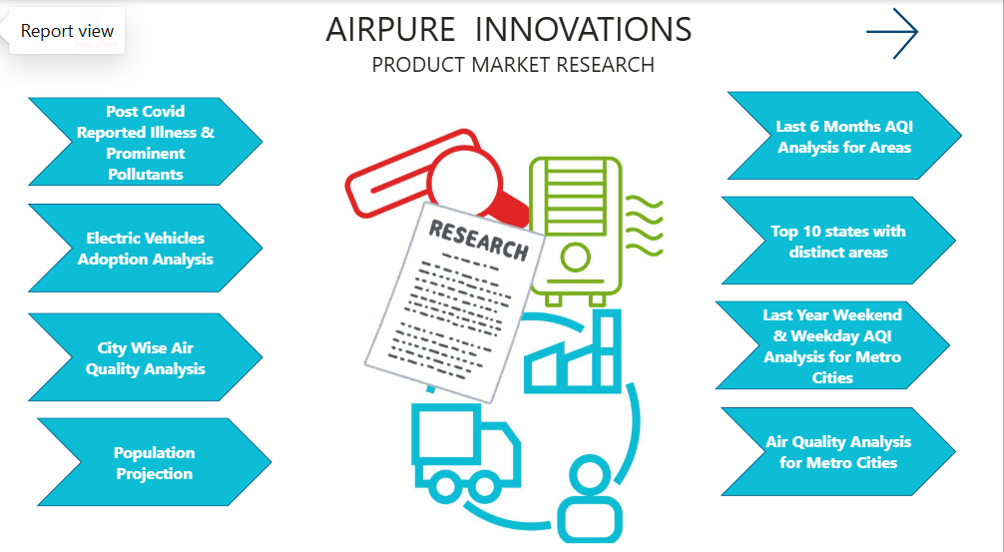

Slide 2




Project
Summary
Data Model
Charts & Insights
Dashboard

Slide 3
Project Summary
"AirPure Innovations" is a startup born out of the air quality crisis in India, with 14 cities ranking among the world’s top 20 most polluted urban centers. The company is in the early stages of product development and is unsure whether there is a strong, sustained demand for its air purifier product.
Before committing to production and R&D, they want to study the market before they launch their product.
Key Questions AirPure Innovations is seeking answers for are
pollutants or particles their air purifier should target
Cities that have the highest demand for air purifiers
How EV adoption is affecting the Air Quality Index
Weekend & Weekday is their any difference in Air Quality Index
Corelation of AQI with respiratory diseases.
Extract the Data
Create Dashboard
Clean the Data
Project Pipeline
Create Visuals
Transform the Data
Analyse the Data

Slide 4
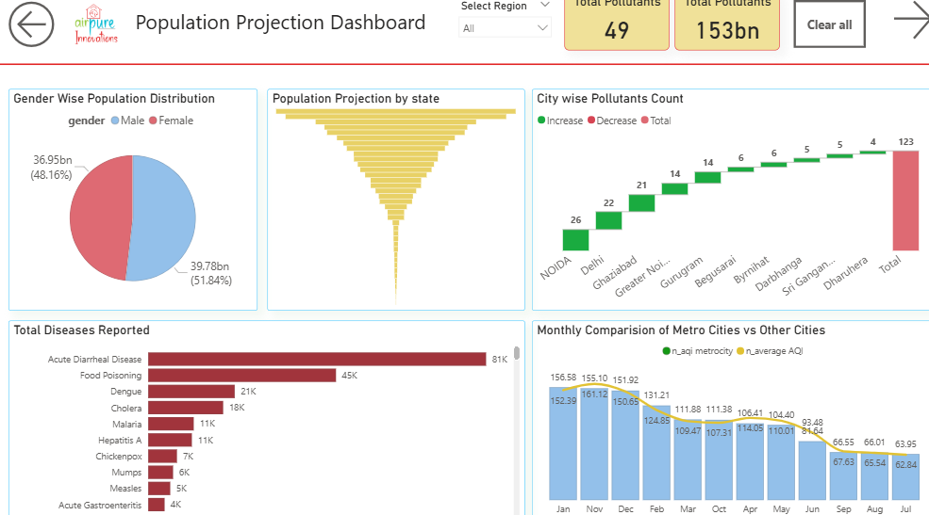
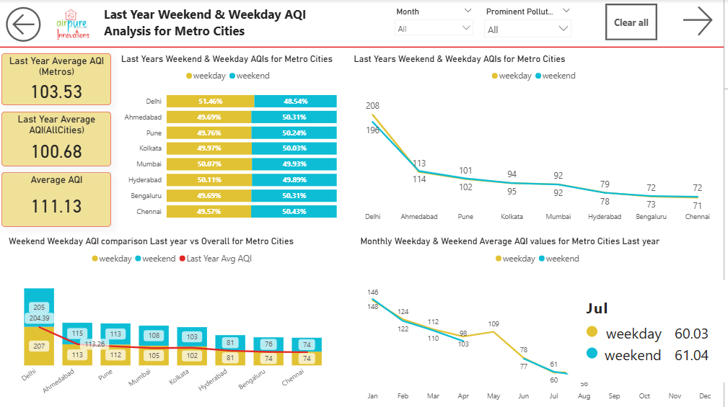
Dashboards
Population Projection
Weekday & Weekend Analysis

Slide 5
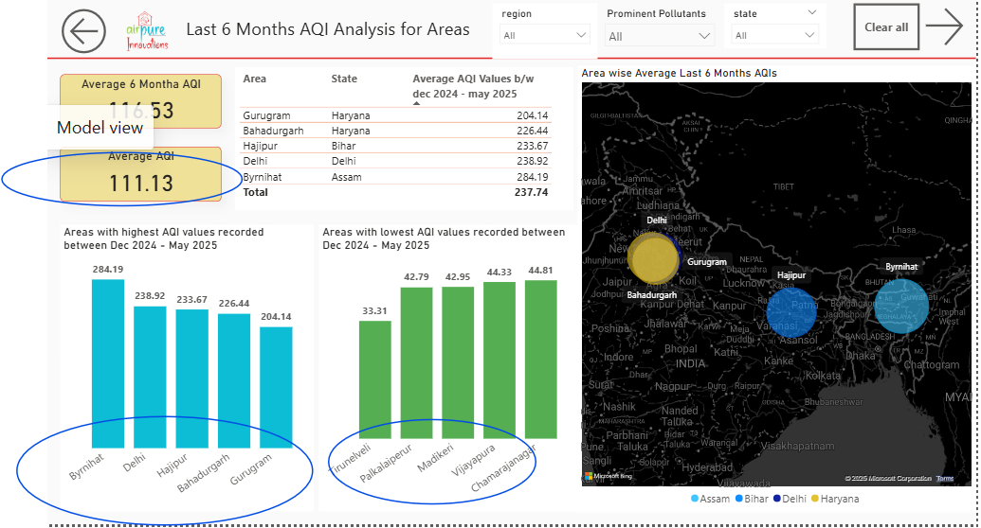
Charts & Insights
AREA WISE AQI ANALYSIS(LAST 6 MONTHS)
Last 6 months Average AQI’s
TOP 5 AREAS (High Air Quality Index)
TOP 5 AREAS (High Air Quality Index)
For all Areas: 116.53 vs Top 5 Areas : 237.74
 | Areas
1. | Byrnihat
2. | Delhi
3. | Hajpur
4. | Bahadurgarh
5. | Gurugram
 | Areas
1. | Tirunelveli
2. | Palkalaiperur
3. | Madkeri
4. | Vijayapura
5. | Chamarajnagar
with such a huge difference between the Average AQI’s recorded for all areas and the top 5 Areas Airpure Innovations has a huge market in these Top 5 Areas with high AQIs
All top 5 Areas with high Air Quality Index values fall in North and North-East regions. 2 of these Areas Bahadurgarh & Gurugram comes from the same state - Haryana

Slide 6
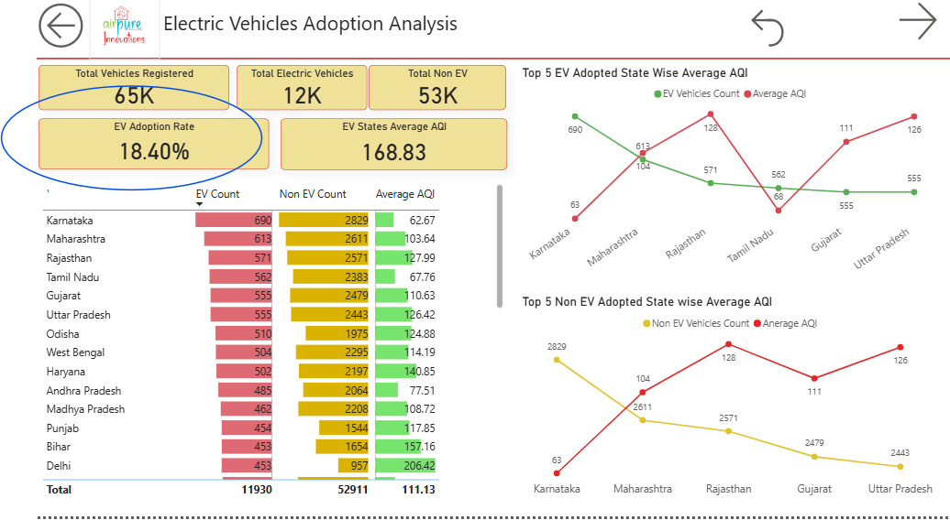
Charts & Insights
Electric Vehicles Analysis
EV Adoption Rate - 18.40 % This KPI gives us the ratio of number of Electric Vehicle registered to the total Vehicles registered. Total Vehicles : 65 K Non EV : 53 K EV: 12k
Looking at the charts provided States with huge market for Electric Vehicles are also the states with higher demand for the vehicles (irrespective of EV or Non EV) hence average AQI’s are not affected based of high demand of EV.

Slide 7
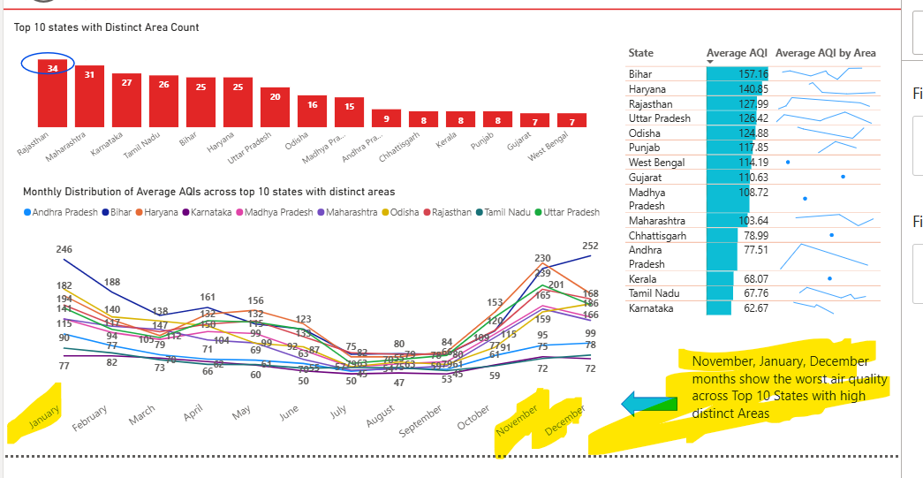
Charts & Insights
Monthly AQI Report for Top 10 States with Distinct Area Count
Top 3 States with distinct areas are
Rajasthan
Maharashtra
Karnataka
Top 3 Months recording high AQI in these states
December
January
November
Since winter months are prone to cold flu, “Airpure Innovations” can focus promoting their product in these months. Mainly focussing on the features such as air purifiers can filter viruses causing these ailments and help you be better prepared for winters.

Slide 8
Charts & Insights
Weekend & Weekday AQI’s
This reports looks into Weekend & Weekday AQI’s recorded across Metro Cities last year
These 3 cities had the highest AQI values
Delhi
Ahmedabad
Pune
Month of July has recorded the least AQI’s
However irrespective of High & Low AQI values the weekend & weekday AQIs have been consistent and there is very less significant difference noticed. Weekend AQIs are slightly less compared to weekdays

Slide 9
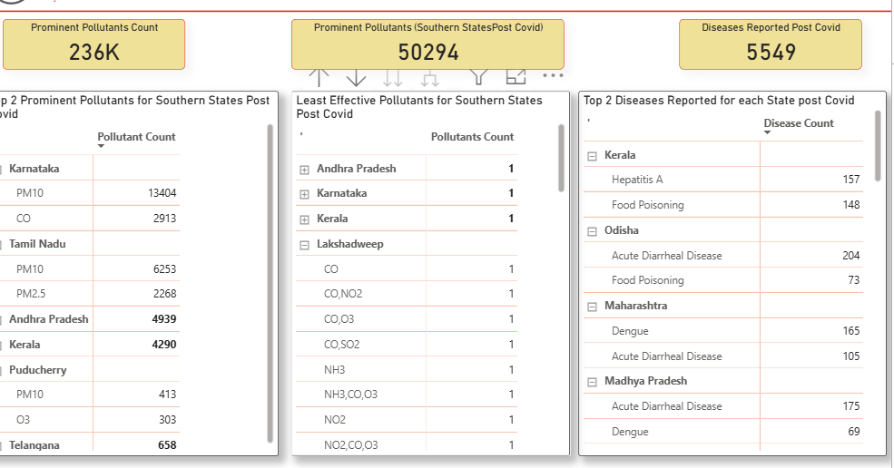
Charts & Insights
Top 2 Prominent Pollutants & Diseases Reported Post Covid
The Charts here present a detailed report for Prominent Pollutants & Diseases reported per state.
Post Covid Total Number of Diseases reported across Country is 5,549.
This table shows the top 2 diseases reported for each state.
Top 3 states with highest number of diseases reported being
Kerala
Odisha
Maharashtra
These tables shows the top 2 & bottom 2 pollutants found each South Indian State
PM 10 was recorded as highest pollutant.

Slide 10
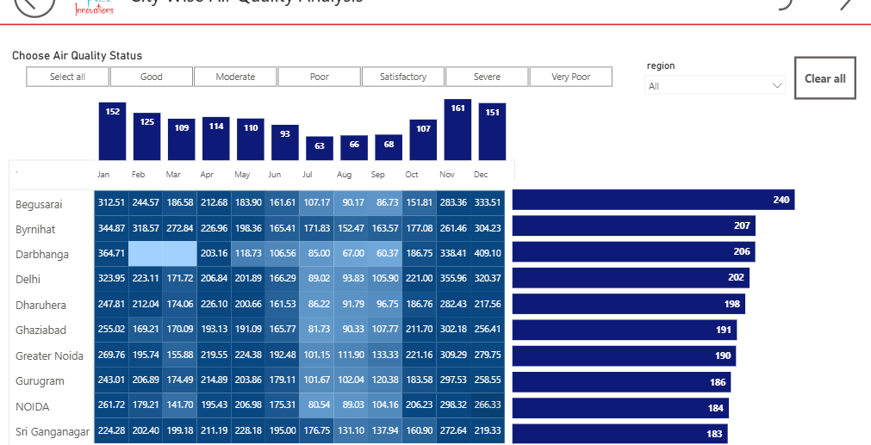
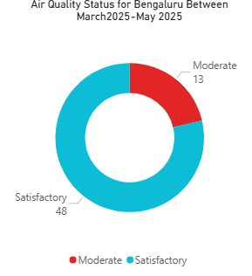
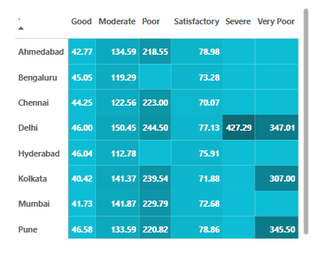
Charts & Insights
AIR QUALITY STATUS
This is the Monthly Performance Analysis for Top 10 Cities recording the Average AQIs.
AQI’s can be checked based on the air quality status (Good, Moderate, Severe etc.)
Air quality status recorded for Bengaluru in the time- period March2025- May 2025 falls in only two categories.
48% : Satisfactory
13% : Moderate
Average AQIs recorded across all metro cities based on Air Quality Status

Slide 11
Key Insights
Using Weekend weekday Analysis, we can say that there is only a slight difference in AQI values this can suggest pollution sources are consistent year-round (e.g., industrial emissions, construction dust, traffic that doesn’t drop much on weekends).
Top 2 Pollutants are PM10 & PM2.5
The EV Analysis report shows AQIs are not affected even in the EV Adopted states
What does this mean to Airpure Innovations
This could be because EV adopted states are also the states with high demand for vehicles
This could be due to heavy construction, dust etc. hence focus on → developing filters optimized for dust-heavy environments and design units that are easy to maintain in dusty climates. → emphasize CADR (Clean Air Delivery Rate) for particulate matter, real-time PM2.5/PM10 sensors, and auto-adjust modes.
Prioritize Filtration Technology → highlight HEPA H13 or higher and multi-stage filtration that can effectively trap particles as small as 0.3 microns (for PM2.5) and larger coarse particles (for PM10).
What does this mean to Airpure Innovations
What does this mean to Airpure Innovations
→ Since EVs aren’t moving the AQI needle, prioritize pollutants from non-vehicular sources (PM2.5, PM10 from dust, industry, crop burning).
→ Develop filtration solutions specifically for regions with heavy industrial particulate emissions and seasonal dust events.
Incorporate this feature → High-efficiency particulate filters with dust and smoke modes, and AQI display to make invisible pollution visible to consumers.
This finding tells them they should sell on consistency. Targeting Corporates & residential alike. A broader sales focus is needed. Year-round marketing & inventory → no seasonal weekday/weekend targeting instead, maintain steady supply.
Indoor air quality awareness → since exposure is constant, highlight how indoor purifiers protect 24/7, not just during peak traffic days.
Features to be implemented in their product → promote continuous filtration modes, energy-efficient operation, and automatic AQI sensors.
Strategies to follow
Consumer Education → run campaigns explaining the difference between PM10 & PM2.5, and their health effects (respiratory, cardiovascular). This builds trust and urgency.
Strategies to follow
→ Educate customers that even in “green transport” states, indoor air pollution remains harmful, so air purifiers are still essential.
Seasonal Campaigns → Target sales peaks during known pollution seasons (e.g., post-harvest stubble burning in North India, construction booms).
Market Messaging → position the product as “Designed for India’s Dust & Fine Particle Pollution” — targeting both urban and semi-urban consumers.

Slide 12
Key Insights
Since Top 3 states with highest distinct area counts are Rajasthan, Maharashtra, Karnataka & Peak AQI months being December, January, November Highest AQI areas:** North & North-East regions
Airpure Innovations should focus these things in their product
Feature | Target Pollutant / Region Insight | Expected Benefit
Pre-filter + HEPA H13/H14 | PM10 & PM2.5 (top pollutants) | Captures >99.97% of fine and coarse particles, improving indoor air quality significantly
Activated Carbon Layer | VOCs, smoke (North & North-East winter smog) | Removes odors, chemicals, and smoke from stubble burning/festive fireworks
Auto AQI Sensor & Adaptive Mode | High AQI spikes in Nov, Dec, Jan | Dynamically adjusts performance during peak pollution hours without manual intervention
Winter Smog Mode | Seasonal high AQI (North & North-East) | Boosts filtration efficiency in smog-heavy months, reduces exposure during worst days
Dust storm Mode | Rajasthan & dry regions | Prevents filter clogging from coarse dust, improves performance in desert climates
Pollen & Allergy Protection Mode | Karnataka, South regions (allergen-prone) | Reduces pollen-related allergies, improves well-being for sensitive users
UV-C Sterilization | Bacteria/mold on filters in humid areas | Ensures filters remain hygienic, reduces spread of microbes indoors
Whisper Night Mode | All regions | Enables 24/7 use in bedrooms without noise disturbance
Mobile App Integration | Urban consumers (tech-savvy markets) | Enables AQI tracking, filter alerts, remote operation, and education on pollution
Washable Pre-Filters | All regions | Reduces recurring costs, improves sustainability, and extends filter life

Slide 13
THANK YOU

